Slide 1
Office 365 Development

Slide 2
Course Agenda
Deep Dive into the Building Blocks and Services of the SharePoint Platform
Module 1: Developing Advanced Workflow Scenarios in Office 365
Module 2: Deep Dive into SharePoint Lists for Data Storage
Module 3: Deep Dive into SharePoint Lists with REST APIs
Module 4: Deep Dive into SharePoint Lists with CSOM APIs
Module 5: SharePoint 2013 Remote Event Receivers
Module 6: Deep Dive into Search Scenarios in Office 365
Module 7: Deep Dive into Business Connectivity Services in Office 365
Module 8: Developing Advanced Taxonomy Scenarios in Office 365

Slide 3
Developing Advanced Workflow Scenarios in Office 365

Slide 4

Agenda
Intro
Workflow Authoring Tools
Activities & Actions
Types of Workflows
Tasks & Forms
Calling Web Services
Workflow Forms

Slide 5
Overview

Slide 6
Developer vision
USERS
DATA
HTML

Slide 7

SharePoint App Building Blocks
SharePoint Apps
aspx
Databases
png
master
CSS
js
Web Services
SharePoint
REST
CSOM
SharePoint API
Managed
Metadata
Search
Service
Workflow
Service
BCS
List and Libraries
Service Applications

Slide 8
What - Workflow
Used to automate business process
Introduced in SharePoint 2007; updated in 2010
SharePoint 2013 introduced significant changes
.NET 3.5 Workflow Foundation used in SharePoint 2010 included in SharePoint 2013 for backwards compatibility
Workflows in SharePoint 2013 handled by Workflow Manager 1.0
Full parity in features & capabilities between SharePoint On-Premises & SharePoint Online
Notes:
Workflow is used to automate business process that typically involve some sort of human or external system interaction
Workflow was introduced in SharePoint 2007 and updated in 2010
In SharePoint 2013 Microsoft made significant changes to the Workflow story
.NET WF engine used in SharePoint 2010 still present for backcompat
SP 2013 “outsourced” WF processing & management to new product: workflow manager
Workflow works same way, with full parity between on-prem & office 365

Slide 9
Why - Workflow
Automate process in your custom apps
Great for long running processes
Client-side apps can leverage to protect IP
Apps can leverage to execute long running process
Apps can leverage using SharePoint UX concepts in custom solutions such as history lists, task lists & forms
Notes:
Most businesses have repeatable processes they use in their organization
Many of these processes can automate these using a customizable workflow engine
Developers can leverage this same platform in custom applications
Client-side apps can use this to
Protect business logic & IP
Execute long running processes
Automate processes that are well integrated with SharePoint’s UX
History list
Task list
Forms

Slide 10
Workflow Manager – How it Works
Workflow Manager exists external to SharePoint
Similar to SharePoint, stand up a workflow farm
Loose connection between SharePoint & Workflow Manager farms
Workflows are “outsourced” from SharePoint to Workflow Manager
Workflow Manager handles all workflow execution
Workflow Manager & SharePoint 2013 Communicate via REST
All calls authenticated using OAuth, specifically via S2S high-trust

Slide 11
Workflow Platform Improvements
Workflow Manager hosts the .NET Framework 4.5 Workflow Foundation version
Added support for making REST / OData based Web Service calls
Added support for complex hierarchical data via DynamicValue
Workflow Manager: much more transparent
Own set of API’s for interrogation & interacting with the Workflow Manager farm

Slide 12
Workflow Platform Improvements (ctd)
Full parity between deployment types
Office 365
On-Premises
New Workflow Services CSOM / JSOM
Forms are easier to build
Based on ASP.NET & JSOM
Include in SharePoint Apps
Great option for protecting data sources & IP within SharePoint Hosted Apps

Slide 13
Workflow Authoring Tools

Slide 14
SharePoint Designer
Audience: power users / end users
Real-time workflow authoring
Developers should keep in mind…
No debugging
Can’t connect to AppWeb’s
Can’t package workflows
Can’t create apps
Can’t create state machine workflows
Limited support for workflow forms

Slide 15
Visual Studio
Audience: developers
Supports packaging workflows into:
Sandboxed solutions
SharePoint apps
Rich debugging support
Full support for creating custom workflow forms

Slide 16
Activities & Actions

Slide 17
Activities & Actions
Workflows are comprised of activities
Activity is a reusable single unit of work
Some activities can contain child activities
Looping or containers like Sequences
Developers can leverage activities from Workflow Foundation, Workflow Manager & SharePoint

Slide 18
Workflow Activities in Visual Studio
SharePoint 2013 Specific Activities
List Activities
Task Activities
User Activities
Utility Activities
Base Workflow Foundation 4.5 & Workflow Manager 1.0 Activities
Workflow Manager 1.0 Microsoft.Activities
Workflow Foundation 4.5 System.Activities
SharePoint Server 2013 Microsoft.SharePoint.WorkflowServices.Activities

Slide 19
List Activities
Check In Item
Check Out Item
Copy Item
Create List Item
Delete List Item
LookupSPList
LookupSPListItem
LookupSPListItemId
UndoCheckOutItem
UpdateListItem
WaitForFieldChange
WaitForItemEvent

Slide 20
Task, User & Utility Activities
Task:
SingleTask
CompositeTask
User Activities:
LookupSPGroup
LookupSPGroupMembers
LookupSPPrincipal
LookupSPPrincipalId
LookupSpUser
Utility:
AppOnlySequence
DelayUntil
Email
LookupSPChoiceFieldIndex
TranslateDocument
WaitForCustomEvent
WriteToHistory

Slide 21
Workflow Foundation 4.5 Activities
WriteLine
Control Flow:
Sequence
Flowchart
StateMachine
Assign
Core Control:
If
ForEach
While
Pick
Parallel

Slide 22
Workflow Manager 1.0 Activities
Core Activities:
SetUserStatus
GetConfigurationValue
Web Service Activities:
HttpSend
BuildDynamicValue
ContainsDynamicValueProperty
CopyDynamicValue
CountDynamicValueItems
CreateDynamicVlaue
GetDynamicValueProperties
GetODataProperties
GetDynamicValueProperty<T>
IsEmptyDynamicValue
ParseDynamicValue

Slide 23
Types of Workflows

Slide 24
Three Types of Workflow Supported
Sequential
Flowchart
State machine

Slide 25
Sequential / Procedural Workflows
When working with a customer, this is always where they seem to start
Workflows have a prescribed linear path to follow
May / may not have loops & branches

Slide 26
Sequential Workflow Pros & Cons
Pros (advantages)
Simple to create
Easily modeled using Visio
Ideal for predetermined, ordered tasks that have a more systematic behavior
Cons (disadvantages)
Limited in how complex they can get
Not ideal for event driven, flexible or reactive processes

Slide 27
Flowchart Workflows
Flowchart
Container activity for FlowDecision & FlowSwitch activities
FlowDecision
Similar to a “If” statement – condition evaluates to TRUE or FALSE
FlowSwitch
Similar to a nested “If” or a “switch” statement in C#
Multiple options based on a condition
Flowchart workflows can live within sequential or state machine workflows… and even other flowchart workflows!

Slide 28
Flowchart Workflow Pros & Cons
Pros (advantages)
Adds flexibility for modeling decision processes
Adds decision making modeling of a process without using loops of loops
Cons (disadvantages)
Not ideal for event driven, flexible or more reactive behaviors

Slide 29
State Machine Workflows
Define different states of the business process
Define how you transition FROM one state TO another state
Can define multiple transitions from a single state to one or more states

Slide 30
State Machine Workflow Components
State Machine Activity
State Activity
Final State Activity
Transition

Slide 31
State & Final State Activity
State Activity
Entry Action
Exit Action
Final State Activity
Entry Action

Slide 32
Transition
Trigger
Condition
Action

Slide 33
State Machine Workflow Pros & Cons
Pros (advantages)
Very flexible and easy to add a new condition to transition from one state to another
Easily allows modeling real world business process
Ideal when there’s human interaction or when the process needs to be more reactive
Cons (disadvantages)
Can get complex quickly
When troubleshooting, can be tedious to step through as you have to open a lot of states & transitions to follow the process
Not ideal for ordered steps, decisions or systematic processes

Slide 34
Calling Web Services

Slide 35
Workflows & Web Services
Use to replace custom business logic within workflows
Request or post data to web service
Processing of complex JSON responses
DynamicValue: New Object Type
Supports hierarchical structures
Supports child objects
Extract to another dynamic value variable
Most SharePoint activities leverage this capability

Slide 36
Custom Web Services for Workflows
Recommended: Create OData Services
WCF Data Services 5.*+
OData services
REST service
Securing Options
Basic Authentication
OAuth2

Slide 37
demo
Sequential Workflows & Updating List Data With Web Services

Slide 38
Tasks & Forms

Slide 39
Workflow Tasks
Adds human element to workflow in SharePoint
Can be assigned to: person / group / multiple people
Users receive email alert when task assigned to them
Automatic reminder, due dates, overdue reminders & reassignment of task after specified duration
When creating association, associate a workflow task list to the definition

Slide 40
Creating Custom Tasks
All OOTB tasks based on the content type - Workflow Task (SharePoint 2013)
Custom Tasks in SharePoint 2013
Create custom content type
Don’t create custom form
In task activities, specify your content type

Slide 41
Task Content Type
Name:
Workflow Task (SharePoint 2013)
ID:
0x0108003365C4474CAE8C42BCE396314E88E51F
Adds two fields:
Task Outcome – Approve / Reject
Workflow instance ID

Slide 42
Workflow CSOM

Slide 43
Workflow Services CSOM / JSOM
Available in both CSOM & JSOM
Comprised of 5 components / services
Workflow Service Manager
Deployment Service
Subscription Service
Instance Service
Interop Service
Makes association & initiation forms possible

Slide 44
Workflow Forms

Slide 45
Workflow Forms in SharePoint 2013
All forms are ASP.NET / HTML pages
Deployed using SharePoint solutions or SharePoint apps
Forms communicate with SharePoint via CSOM
Visual Studio includes templates for association and initiation forms
No custom task forms – use custom task content types & CSR for customized presentation

Slide 46
Association Forms
Shown after the SharePoint association form
Responsible for creating workflow history & task list (if indicated) & the workflow association
Common Uses:
Collecting configuration information
Collecting default values in initiation forms

Slide 47
Initiation Forms
Shown when a workflow is manually started
Auto-start workflows skip the initiation form
Common uses:
Collect workflow instance-specific configuration data
Collect special messages to Include in tasks / email notifications

Slide 48
demo
State Machines, Forms & Tasks

Slide 49
Resources
Office 365 Development Overview

Slide 50
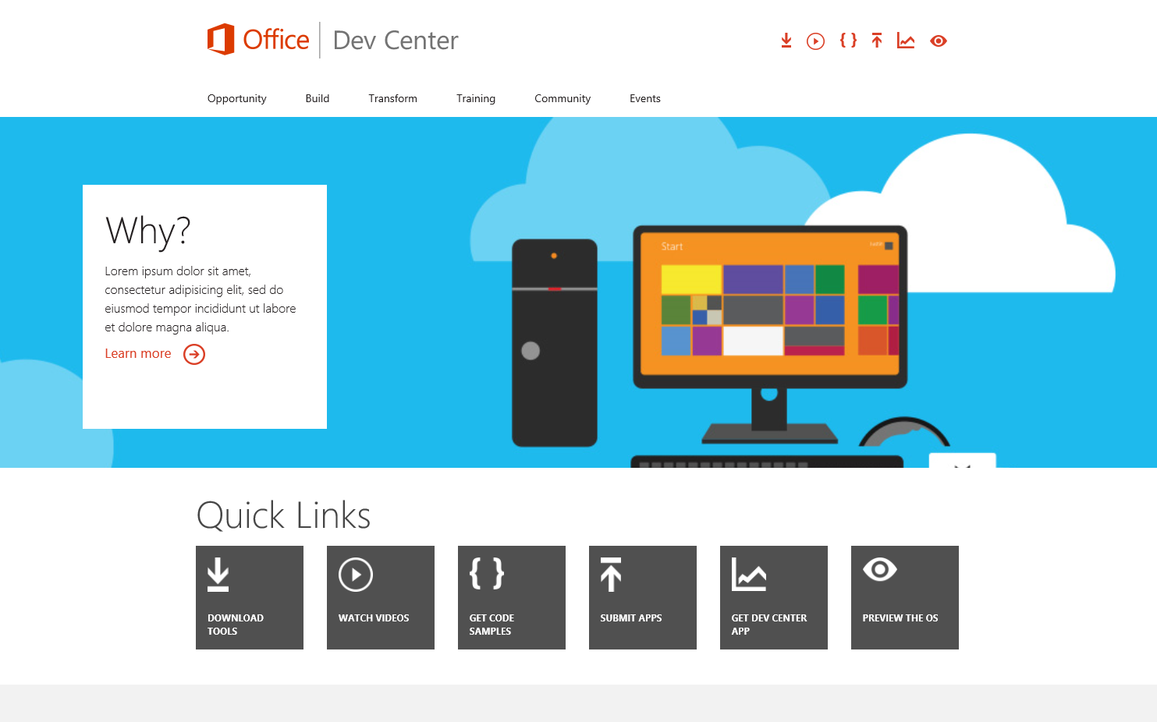
Office 365 Developer Center
dev.Office.com
Opportunity
Build
Transform
Code Samples
Patterns & Practices
API Reference
Community

Slide 51
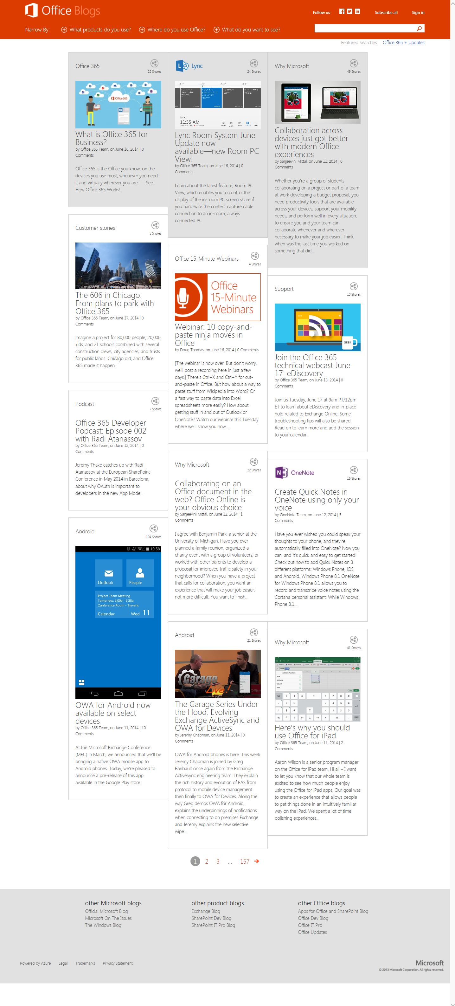
Office Blogs
Office 365 news
Dev announcements
Events
Garage Series videos
Weekly podcast

Slide 52
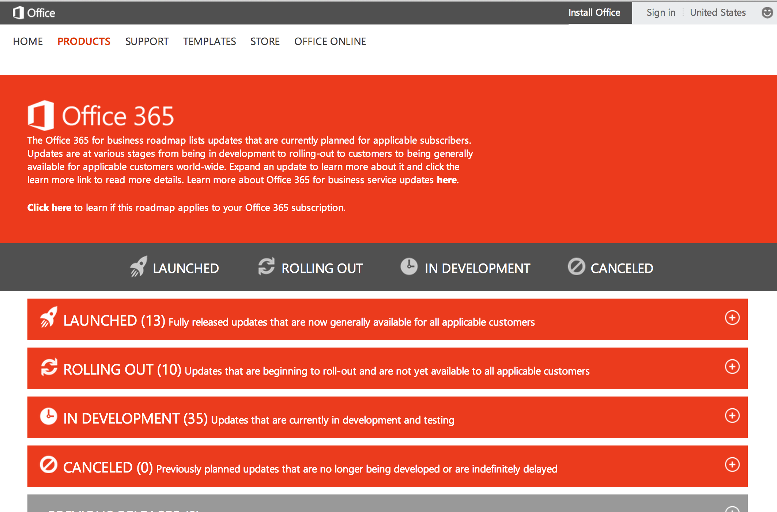
Roadmap
Monthly updates
Developer features
Associated blog posts

Slide 53
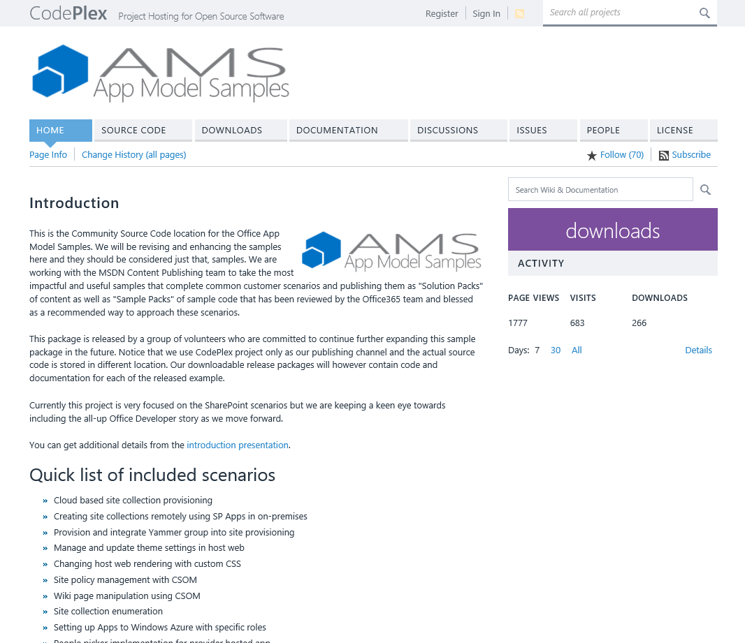
Patterns & Practices
Providing App Model Patterns for common Full Trust Code scenarios
30+ Visual Studio Projects
Common scenarios
Branding
Site Provisioning
Remote Event Receivers
Large file support
Taxonomy driven navigation
And much more…
Contribute
Open source coming soon!

Slide 54
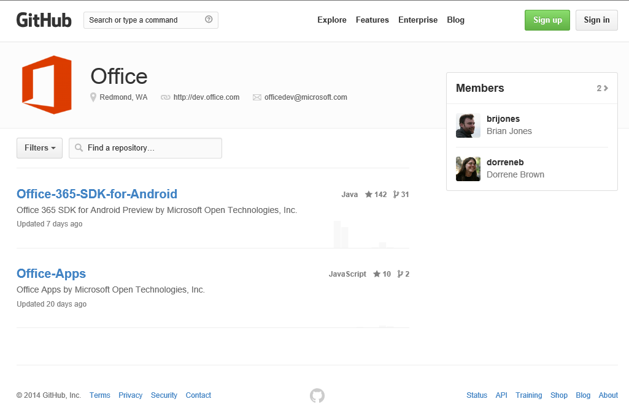
GitHub
Github.com/OfficeDev
SDKs
Android SDK
Code Samples
WikiPedia App for Word
Campaign Manager for Android
Expense Manager for Windows 8
Research Manager inc. AngularJS
Building Snippets for Word
Contribute
We want your enhancements and your samples!

Slide 55
Courses
Deep Dive into the Building Blocks and Services of the SharePoint Platform
Module 1: Developing Advanced Workflow Scenarios in Office 365
Module 2: Deep Dive into SharePoint Lists for Data Storage
Module 3: Deep Dive into SharePoint Lists with REST APIs
Module 4: Deep Dive into SharePoint Lists with CSOM APIs
Module 5: SharePoint 2013 Remote Event Receivers
Module 6: Deep Dive into Search Scenarios in Office 365
Module 7: Deep Dive into Business Connectivity Services in Office 365
Module 8: Developing Advanced Taxonomy Scenarios in Office 365

Slide 56
Summary
Intro
Workflow Authoring Tools
Activities & Actions
Types of Workflows
Tasks & Forms
Calling Web Services
Workflow Forms

Slide 57
Developer Program Launch
1 YEAR FREE
E-mail Newsletters
Free Developer Subscription
Free Training
Free Tools
Webinars
http://dev.office.com/devprogram

Slide 58


Engage
Office 365 Network
https://www.yammer.com/itpronetwork
Twitter
S
S
t
t
a
a
r
r
t
t
@OfficeDev
Stack overflow
[ms-office]
Channel 9 Dev Show
http://aka.ms/O365DevShow
Podcasts http://dev.office.com/podcasts
Snack Demos
http://aka.ms/o365DevSnackDemos
UserVoice
http://officespdev.uservoice.com/

